Slide 1


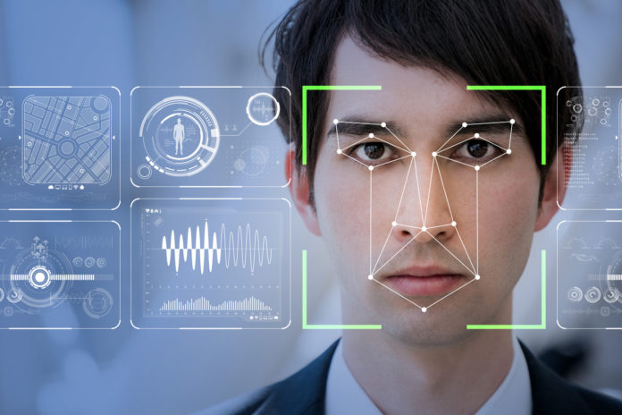
Sentiment Analysis (Face Emotion Detection)
By: Gargi Agarwal
Pinkush Gupta
Soyab Khan
Mentor: Ms. Vidushi

Slide 2

What is sentiment analysis?
It is an approach to face emotion detection that identifies the mood of a person.
We can understand the person’s opinion and attitude towards any topic that the person is happy, sad, angry or neutral by there face expression.

Slide 3

What is Facial Emotion recognition?
Facial emotion recognition is the process of detecting human emotions from facial expressions. The human brain recognizes emotions automatically, and software has now been developed that can recognize emotions as well. This technology is becoming more accurate all the time and will eventually be able to read emotions as well as our brains do.
AI can detect emotions by learning what each facial expression means and applying that knowledge to the new information presented to it. Emotional artificial intelligence, or emotion AI, is a technology that is capable of reading, imitating, interpreting, and responding to human facial expressions and emotions.
ANGER
JOY
FEAR
HAPPINESS
SADNESS
SURPRISE

Slide 4
How our system works?
It works basically in three stages are:
Facial Detection
Facial Recognition
Emotion Detection

Slide 5
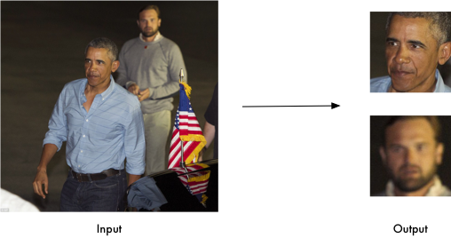
Facial detection
Ability to detect the location of face in any input image or frame. The output is the bounding box coordinates of the detected faces.
Facial detection is the first part of our pipeline. We have used the python library Face Recognition that we found easy to install and very accurate in detecting faces. This library scans the input image and returns the bounding box coordinates of all detected faces as shown:

Slide 6
Facial recognition
Compare multiple faces together to identify which faces belong to the same person. This is done by comparing face embedding vectors.
Facial Recognition verifies if two faces are same. The use of facial recognition is huge in security, bio-metrics, entertainment, personal safety, etc. The same python library face_recognition used for face detection can also be used for face recognition. Our testing showed it had good performance.

Slide 7
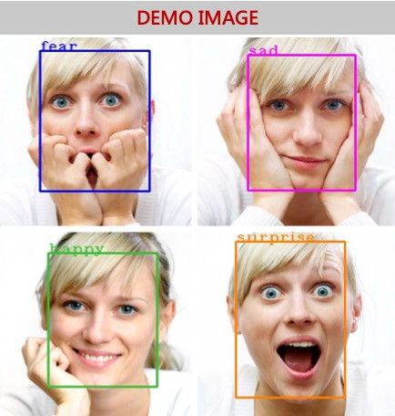
Emotion detection
Classifying the emotion on the face as happy, angry, sad, neutral, surprise, disgust or fear.
Humans are used to taking in non verbal cues from facial emotions. Now computers are also getting better to reading emotions. So how do we detect emotions in an image? We have used an open source data set — Face Emotion Recognition (FER) from Kaggle and built a CNN to detect emotions. The emotions can be classified into 7 classes — happy, sad, fear, disgust, angry, neutral and surprise.

Slide 8
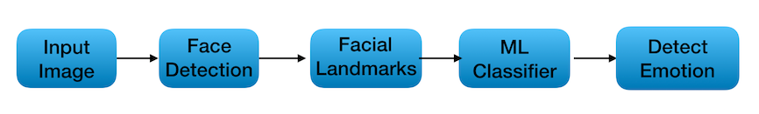
Template creation

Slide 9
Validation phase
In the validation phase, various OpenCV function and Keras function have been used.
Initially a video frame is stored in a video object.
The image frame is converted into grayscale and resized and reshaped with the help of numpy.
A rectangle is drawn around the facial regions and the output is formatted above the rectangular box.

Slide 10

Programming & technology used:
Python
Machine Learning
Data set (Kaggle)
OpenCV

Slide 11
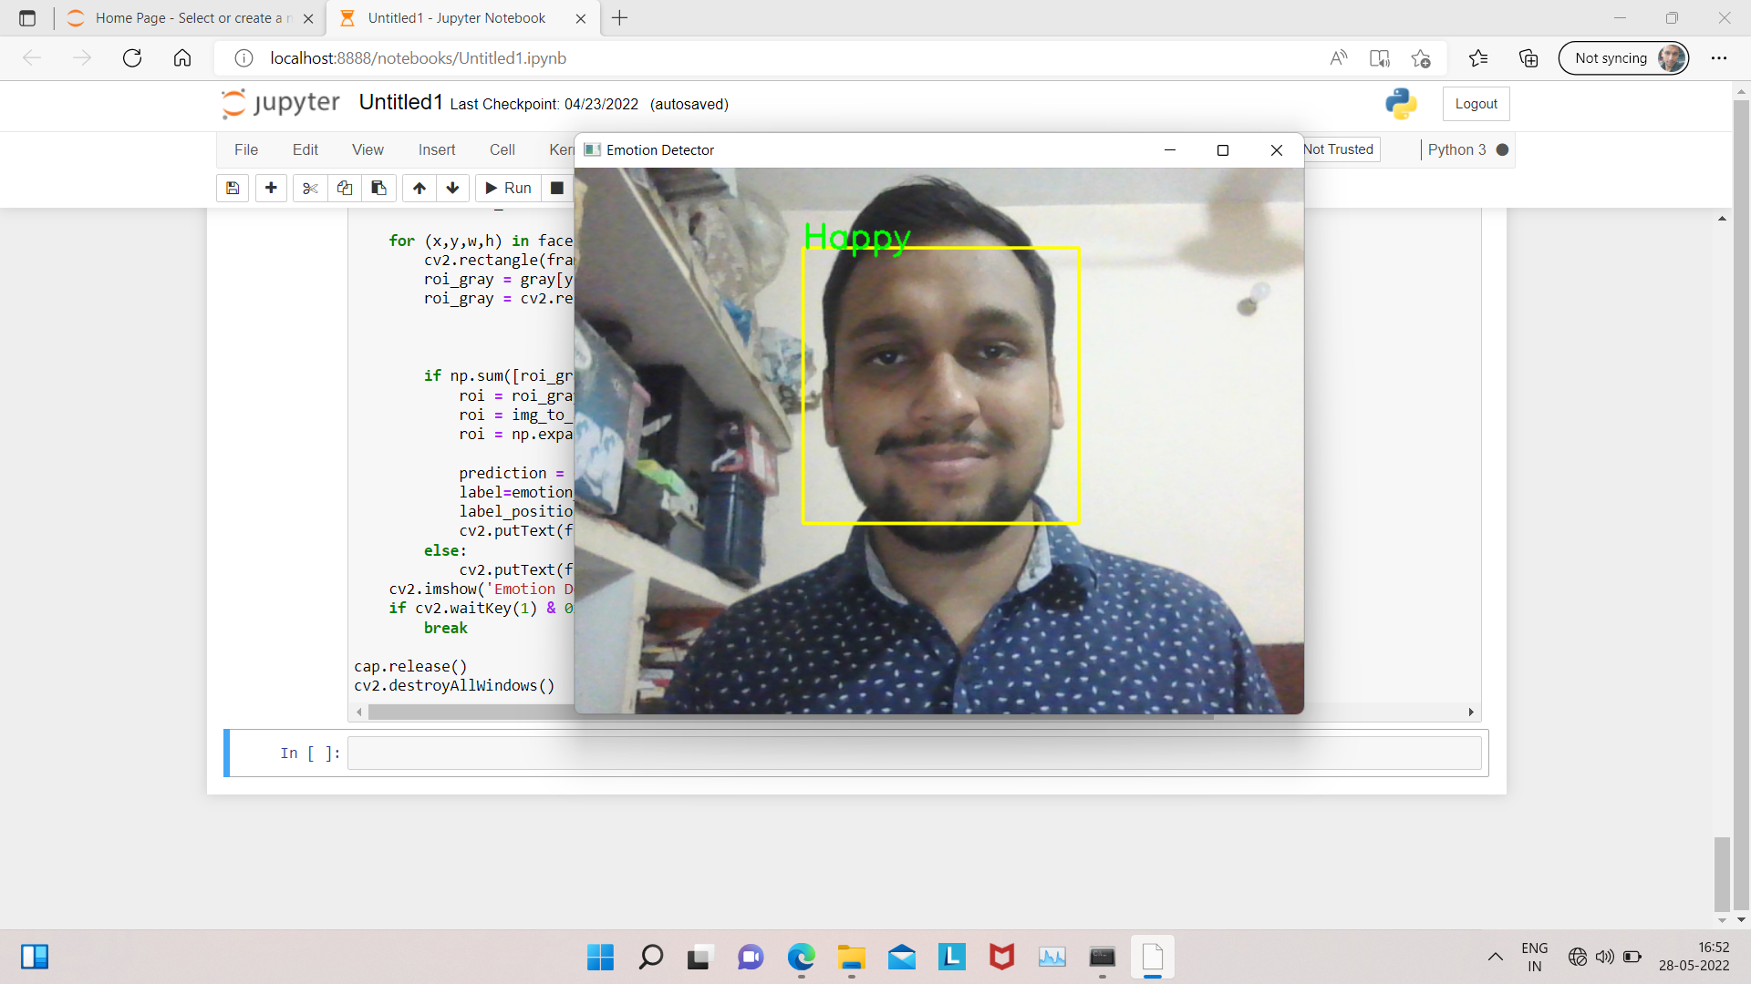
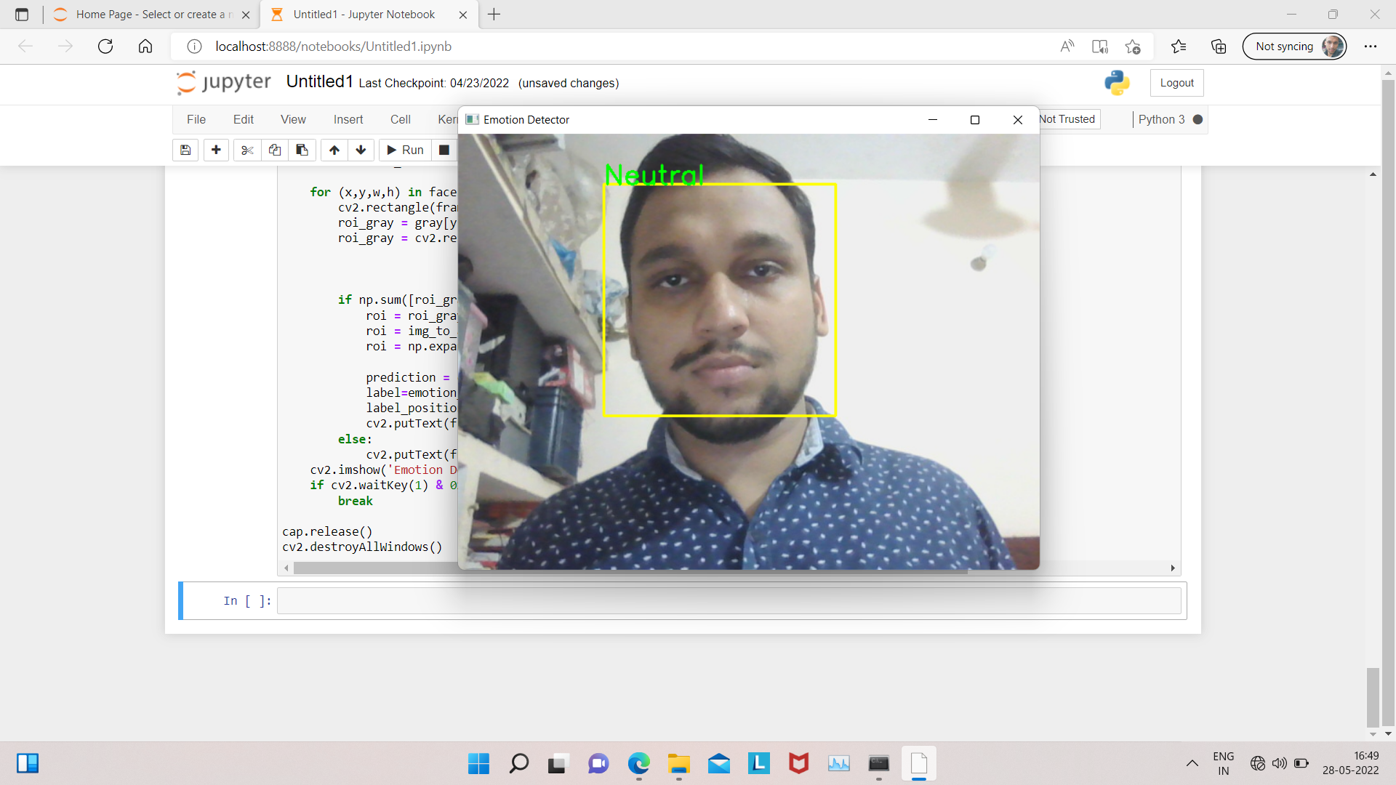
Working output images:

Slide 12
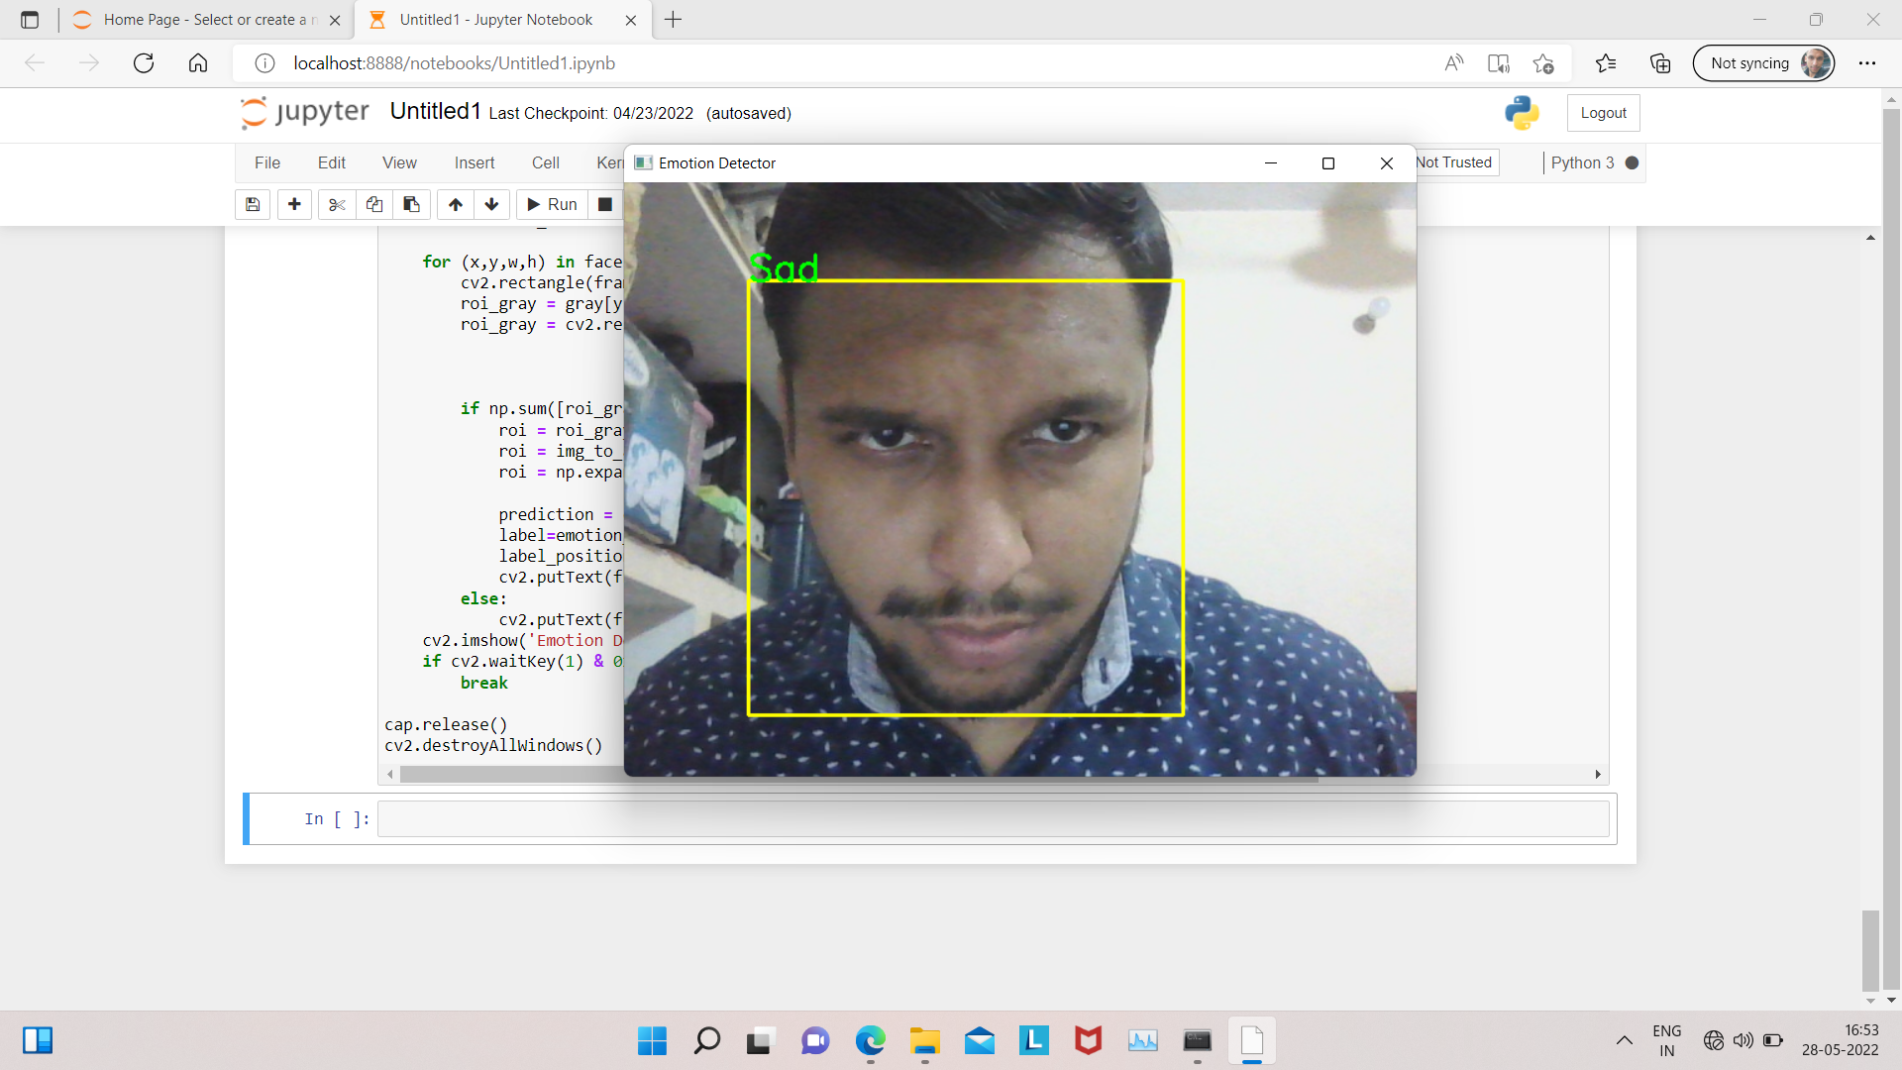
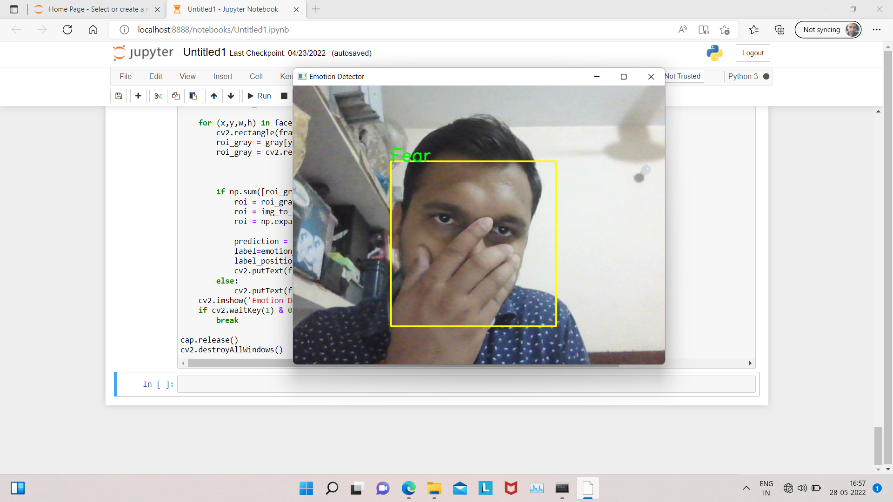
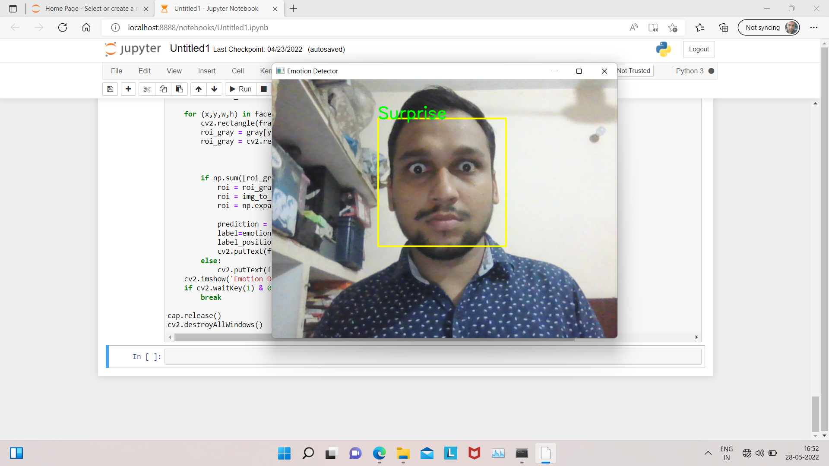
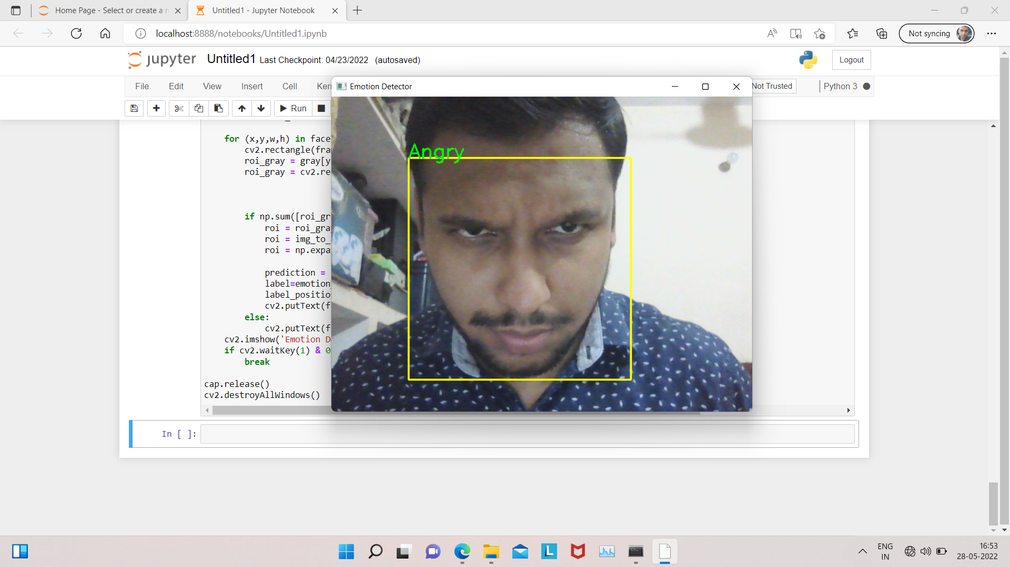

Slide 13

Future scope
WE WILL INTEGRATE OUR PROJECT WITH A CHAT BAESD PLATFORM WITH DOCUMENT SHARING, ONLINE MEETINGS AND MANY MORE EXTREMELY USEFUL FEATURES FOR BUSINESS COMMUNICATIONS ANG EDUCATIONAL INSTITUTIONS.

Slide 14

Thank you

